Slide 1
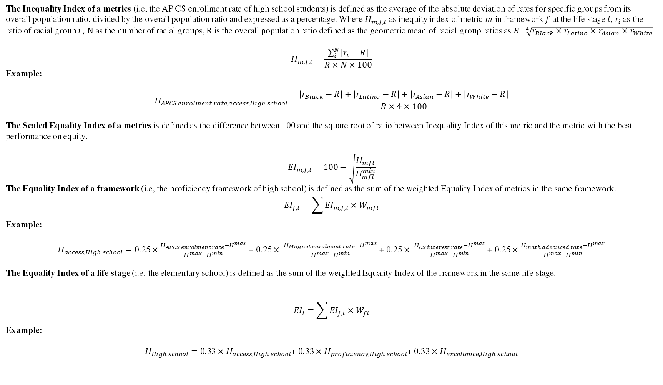
The Inequality Index of a metrics (i.e, the AP CS enrollment rate of high school students) is defined as the average of the absolute deviation of rates for specific groups from its overall population ratio, divided by the overall population ratio and expressed as a percentage. Where ${II}_{m,f,l}$ as inequity index of metric $m$ in framework $f$ at the life stage $l$, $r_{i}$ as the ratio of racial group $i$ , $N$ as the number of racial groups, $R$ is the overall population ratio defined as the geometric mean of racial group ratios as $R$= $\sqrt[4]{r_{Black}×r_{Latino}×r_{Asian}×r_{White}}$
$${II}_{m,f,l}=\frac{\sum_{i}^{N}{|r_{i}−R|}}{R×N×100}$$
Example:
$${II}_{APCS enrolment rate,access,High school}=\frac{\left|r_{Black}−R\right|+\left|r_{Latino}−R\right|+\left|r_{Asian}−R\right|+\left|r_{White}−R\right|}{R×4×100}$$
The Scaled Equality Index of a metrics is defined as the difference between 100 and the square root of ratio between Inequality Index of this metric and the metric with the best performance on equity.
$${EI}_{m,f,l}=100−\sqrt{\frac{{II}_{mfl}}{{II}_{mfl}^{min}}}$$
The Equality Index of a framework (i.e, the proficiency framework of high school) is defined as the sum of the weighted Equality Index of metrics in the same framework.
$${EI}_{f,l}=\sum{{EI}_{m,f,l}×W_{mfl}}$$
Example:
${II}_{access,High school}=\text{0.25}×\frac{{II}_{APCS enrolment rate}−{II}^{max}}{{II}^{max}−{II}^{min}}$ + $\text{0.25}× \frac{{II}_{Magnet enrolment rate}−{II}^{max}}{{II}^{max}−{II}^{min}}$ + $\text{0.25}× \frac{{II}_{CS interest rate}−{II}^{max}}{{II}^{max}−{II}^{min}}$ + $\text{0.25}×$ $\frac{{II}_{math advanced rate}−{II}^{max}}{{II}^{max}−{II}^{min}}$
The Equality Index of a life stage (i.e, the elementary school) is defined as the sum of the weighted Equality Index of the framework in the same life stage.
$${EI}_{l}=\sum{{EI}_{f,l}×W_{fl}}$$
Example:
${II}_{High school}=\text{0.}\text{33}×{II}_{access,High school}$+ $\text{0.}\text{33}×{II}_{proficiency,High school}$+ $\text{0.}\text{33}×{II}_{excellence,High school}$

